Slide 1
INTRODUCTION TO data STRUCTURES and Algorithms

Slide 2
What is computer science
The Study of Algorithms.
This study encompasses four distinct areas:
(i) Machines for executing algorithms- includes everything from the smallest pocket calculator to the largest general purpose digital computer.
(ii) Languages for describing algorithms--these languages can be placed on a continuum. At one end are the languages which are closest to the physical machine and at the other end are languages designed for sophisticated problem solving.
(iii) Foundations of algorithms--here people ask and try to answer such questions as: is a particular task accomplishable by a computing device; or what is the minimum number of operations necessary for any algorithm which performs a certain function
(iv) Analysis of Algorithm-whenever an algorithm can be specified it makes sense to wonder about its behavior. An algorithm's behavior pattern or performance profile is measured in terms of the computing time and space that are consumed while the algorithm is processing. Questions such as the worst and average time and how often they occur are typical.

Slide 3
What is algorithm
An algorithm is a finite set of instructions which, if followed, accomplish a particular task.
OR
Step by step procedure to perform an operation and which(like a map or flowchart) will lead to sought result if followed correctly.
Every Algorithm must satisfy the following criteria:
Input : there are zero or more quantities that are externally applied.
Output: at least one quantity is produced.
Definiteness: Each instruction must be clear and unambiguous. An Algorithms have a definite beginning and a definite end.
Finiteness: the algorithm must terminate after a finite number of steps.
Algorithm produces the same output information given the same input information.

Slide 4
FLOW CHART
An algorithm can be described in many ways.
A natural language such as English can be used but we must be very careful that the resulting instructions are definite (condition iii).
An improvement over English is to couple its use with a graphical form of notation such as flowcharts.
This form places each processing step in a "box" and uses arrows to indicate the next step. Different shaped boxes stand for different kinds of operations.
Most commonly used flowchart symbols are:
The OVAL : an End or a Beginning.
The Rectangle : Process step.
The Arrow : Directional flow.
The Diamond : Call for s decision.

Slide 5
Performance of Algorithm
The performance of an algorithm is measured on the basis of following properties :
Correctness: data structure implementation should implement it’s interface correctly.
Time complexity: Running time or execution time of data structures must be small as possible.
Space complexity: Memory usage of data structure should as little as possible.

Slide 6
Space Complexity
Its the amount of memory space required by the algorithm, during the course of its execution. Space complexity must be taken seriously for multi-user systems and in situations where limited memory is available.
An algorithm generally requires space for following components :
Instruction Space: Its the space required to store the executable version of the program. This space is fixed, but varies depending upon the number of lines of code in the program.
Data Space: Its the space required to store all the constants and variables(including temporary variables) value.
Environment Space: Its the space required to store the environment information needed to resume the suspended function.
But while calculating the Space Complexity of any algorithm, we usually consider only Data Space and we neglect the Instruction Space and Environmental Stack.

Slide 7
Calculating the Space Complexity
For calculating the space complexity, we need to know the value of memory used by different type of datatype variables, which generally varies for different operating systems, but the method for calculating the space complexity remains the same.
Example 1: Example 2:
{ int sum(int a[], int n)
int z = a + b + c; return(z); {
} int x = 0; // 4 bytes for x
for(int i = 0; i < n; i++) // 4 bytes for i
{
x = x + a[i];
}
return(x);
}
Type | Size
bool, char, unsigned char, signed char, | 1 byte
__int16, short, unsigned short | 2 bytes
float, __int32, int, unsigned int, long, unsigned long | 4 bytes
double, __int64, long double, long long | 8 bytes

Slide 8
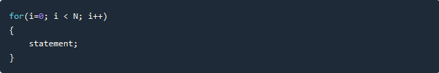
What is Time Complexity?
Time complexity of an algorithm signifies the total time required by the program to run till its completion.
The time complexity of algorithms is most commonly expressed using the big O notation. It's an asymptotic notation to represent the time complexity.
Time Complexity is most commonly estimated by counting the number of elementary steps performed by any algorithm to finish execution.
the most common metric for calculating time complexity is Big O notation. This removes all constant factors so that the running time can be estimated in relation to N, as N approaches infinity.
Above we have a single statement. Its Time Complexity will be Constant. The running time of the statement will not change in relation to N.
The time complexity for the above algorithm will be Linear. The running time of the loop is directly proportional to N. When N doubles, so does the running time.

Slide 9
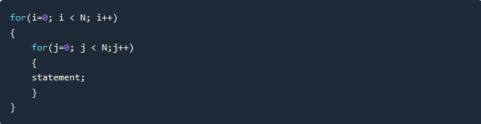
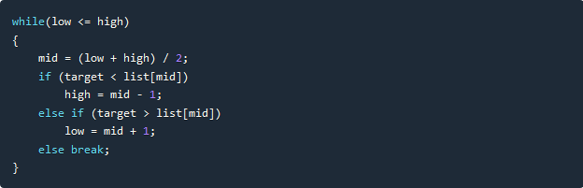
This time, the time complexity for the above code will be Quadratic. The running time of the two loops is proportional to the square of N. When N doubles, the running time increases by N * N.
This algorithm will have a Logarithmic Time Complexity. The running time of the algorithm is proportional to the number of times N can be divided by 2(N is high-low here). This is because the algorithm divides the working area in half with each iteration.
In general, doing something with every item in one dimension is linear, doing something with every item in two dimensions is quadratic, and dividing the working area in half is logarithmic.

Slide 10
computer science is the study of data
Now talking from technical point of view it is unsatisfying to say that the computer science is the study of Algorithms.
The definition places great emphasis on the concept of algorithm, but never mentions the word data.
But from technical point of view we are always processing “DATA”.
That is why we often hear a computer referred to as a data processing machine.
Raw data is input and algorithms are used to transform it into refined data.
So, instead of saying that computer science is the study of algorithms, alternatively, we might say that computer science is the study of data:
(i) machines that hold data;
(ii) languages for describing data manipulation;
(iii) foundations which describe what kinds of refined data can be produced from raw data;
(iv) Structures for representing data.

Slide 11
DATA STRUCTURES
Data Structures are the programmatic way of storing data so that data can be used efficiently.
OR
Data Structures is a systematic way to organize data in order to use it efficiently.

Slide 12
Data Structure is a way of collecting and organizing data in such a way that we can perform operations on these data in an effective way.
Data Structures is about rendering data elements in terms of some relationship, for better organization and storage
Data Structures are structures programmed to store ordered data, so that various operations can be performed on it easily.
It represents the knowledge of data to be organized in memory.
It should be designed and implemented in such a way that it reduces the complexity and increases the efficiency.

Slide 13
Basic types of Data Structures
As we have discussed above, anything that can store data can be called as a data structure, hence Integer, Float, Boolean, Char etc. all are data structures. They are known as Primitive Data Structures.
Then we also have some complex Data Structures, which are used to store large and connected data. Some example of Abstract Data Structure are :
Linked List
Tree
Graph
Stack, Queue etc.
All these data structures allow us to perform different operations on data. We select these data structures based on which type of operation is required.

Slide 14
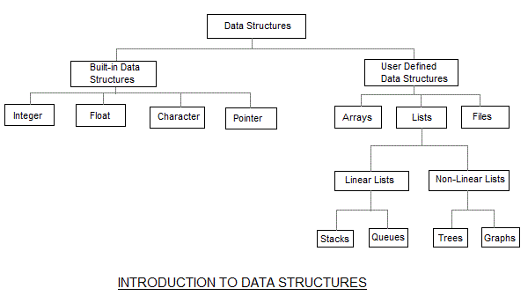

Slide 15
The data structures can also be classified on the basis of the following characteristics
Characterstic | Description
Linear | In Linear data structures,the data items are arranged in a linear sequence. Example: Array
Non-Linear | In Non-Linear data structures,the data items are not in sequence. Example: Tree, Graph
Homogeneous | In homogeneous data structures,all the elements are of same type. Example: Array
Non-Homogeneous | In Non-Homogeneous data structure, the elements may or may not be of the same type. Example: Structures
Static | Static data structures are those whose sizes and structures associated memory locations are fixed, at compile time. Example: Array
Dynamic | Dynamic structures are those which expands or shrinks depending upon the program need and its execution. Also, their associated memory locations changes. Example: Linked List created using pointers

Slide 16
Following terms of data structure we should know:
INTERFACE: represents set of operations that a data structure support. An interface only provides the list of supported operations, type of parameters they can accept and return type.
IMPLEMENTATION: provides the internal representation of data structure and the definition of the algorithm used in operation of data structure.
IMPLEMENTS
INTERFACE
Void method1();
Void method2();
Void method3();
CLASS
Void method1()
{
//method body
}
Void method2()
{
//method body
}
METHOD DEFINITION
METHOD DECLARATION

Slide 17
NEED for data Structure
SEARCHING DATA
SORTING DATA
TO MANAGE PROCESSOR SPEED
SERVE MULTIPLE REQUEST SIMULTANEOUSLY.

Slide 18
EXECUTION TIME
WORST CASE: When a particular data structure takes maximum time
AVERAGE CASE: Depicting average execution time of a data structure.
BEST CASE: Depicting the least possible execution time of an operation of a data structure

Slide 19
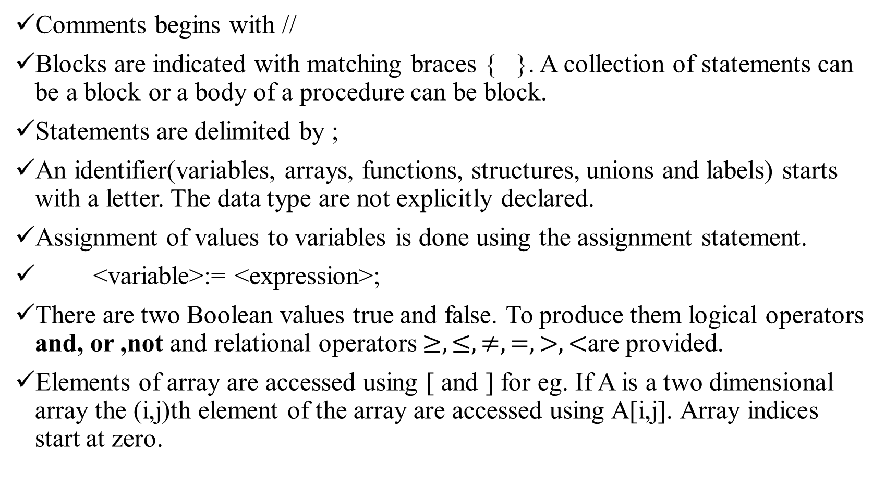
Pseudo-Code Convention of algorithm
Comments begins with //
Blocks are indicated with matching braces { }. A collection of statements can be a block or a body of a procedure can be block.
Statements are delimited by ;
An identifier(variables, arrays, functions, structures, unions and labels) starts with a letter. The data type are not explicitly declared.
Assignment of values to variables is done using the assignment statement.
<variable>:= <expression>;
There are two Boolean values true and false. To produce them logical operators and, or ,not and relational operators $≥,≤,≠,=,>,<$are provided.
Elements of array are accessed using [ and ] for eg. If A is a two dimensional array the (i,j)th element of the array are accessed using A[i,j]. Array indices start at zero.

Slide 20
Following looping statements are employed for ,while ,repeat-until.
As long as <condition> is true statements get executed, <condition> becomes false loop is exited.
Here value1, value2 and step are expression. step can be + or -
Here statements are executed until the <condition> is false and the value of <condition > is calculated after executing statements.
To force exit from any of the above loop break; statement can be used

Slide 21
Here <condition> is a Boolean expression and <statement> ,<statement1>, <statement2> are arbitrary statement .
A conditional statement has the following form
Input and output are done using instruction read and write.
There is only one type of procedure: ALGORITHM. An ALGORITHM consist of heading and a body.
Where Name is name of procedure and <parameter list > is the listing of method arguments. The body of procedure will have one or more statements enclosed with in a { }

Slide 22
As an example the following Algorithm finds and returns maximum of n given numbers:
Now in this algorithm named Max (A, n) are procedure parameters or arguments and Result and i are local variables.

